Slide 1
Optimization Overview
Lecture 17
Lecture 17

Slide 2
Today’s Lecture
Lecture 17
Logical Optimization
Physical Optimization
Course Summary

Slide 3
Logical vs. Physical Optimization
Lecture 17
SQL Query
Relational Algebra (RA) Plan
Logical optimization:
  Find equivalent plans that are more efficient
  Intuition: Minimize # of tuples at each step by changing the order of RA operators
Physical optimization:
  Find algorithm with lowest IO cost to execute our plan
  Intuition: Calculate based on physical parameters (buffer size, etc.) and estimates of data size (histograms)
Optimized RA Plan
Execution

Slide 4
1. Logical Optimization
Lecture 17 > Section 1

Slide 5
What you will learn about in this section
Lecture 17 > Section 1
Optimization of RA Plans
ACTIVITY: RA Plan Optimization

Slide 6
RDBMS Architecture
Lecture 17 > Section 1 > Plan Optimization
How does a SQL engine work ?
SQL Query
Relational Algebra (RA) Plan
Optimized RA Plan
Execution
Declarative query (from user)
Translate to relational algebra expresson
Find logically equivalent- but more efficient- RA expression
Execute each operator of the optimized plan!

Slide 7
RDBMS Architecture
Lecture 17 > Section 1 > Plan Optimization
How does a SQL engine work ?
SQL Query
Relational Algebra (RA) Plan
Optimized RA Plan
Execution
Relational Algebra allows us to translate declarative (SQL) queries into precise and optimizable expressions!

Slide 8
Lecture 17 > Section 1 > Plan Optimization
Recall: Relational Algebra (RA)
Five basic operators:
  Selection: σ
  Projection: Π
  Cartesian Product: ×
  Union: ∪
  Difference: -
Derived or auxiliary operators:
  Intersection, complement
  Joins (natural,equi-join, theta join, semi-join)
  Renaming: ρ
  Division
We’ll look at these first!
And also at one example of a derived operator (natural join) and a special operator (renaming)

Slide 9

Recall: Converting SFW Query -> RA
Lecture 17 > Section 1 > Plan Optimization
Students(sid,sname,gpa)
People(ssn,sname,address)
SELECT DISTINCT
gpa,
address
FROM Students S,
People P
WHERE gpa > 3.5 AND
sname = pname;
How do we represent this query in RA?

Slide 10
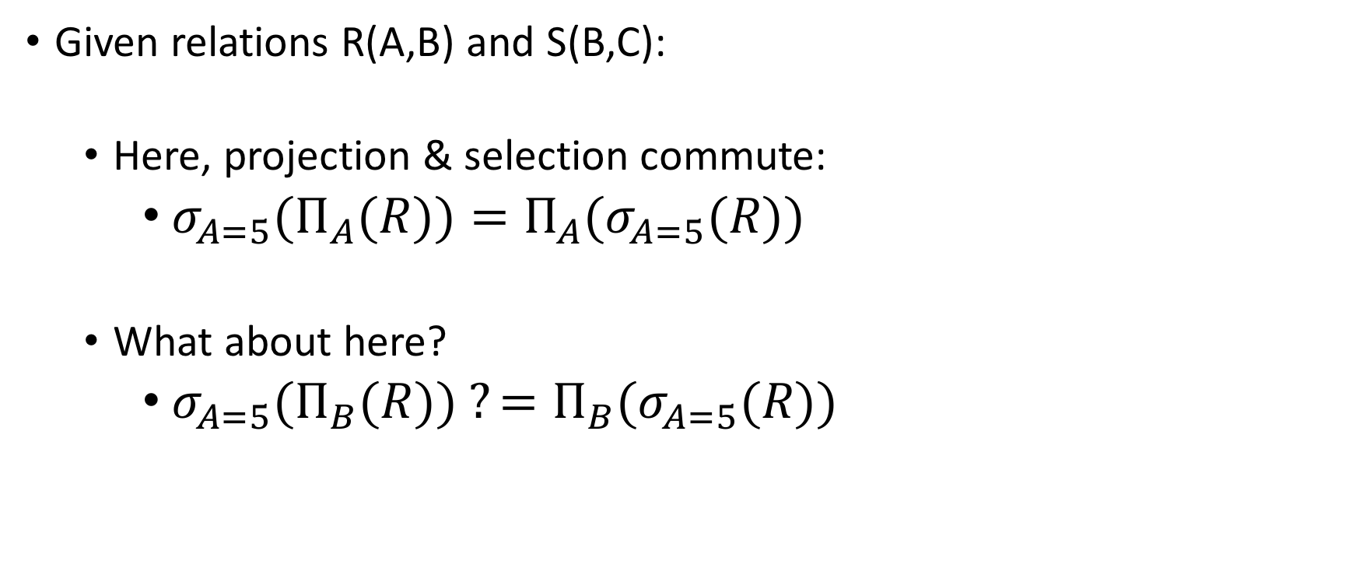
Recall: Logical Equivalece of RA Plans
Lecture 17 > Section 1 > Plan Optimization
We’ll look at this in more depth later in the lecture…

Slide 11
RDBMS Architecture
Lecture 17 > Section 1 > Plan Optimization
How does a SQL engine work ?
SQL Query
Relational Algebra (RA) Plan
Optimized RA Plan
Execution
We’ll look at how to then optimize these plans now

Slide 12
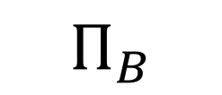

Note: We can visualize the plan as a tree
Lecture 17 > Section 1 > Plan Optimization
R(A,B)
S(B,C)
Bottom-up tree traversal = order of operation execution!

Slide 13
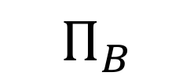
A simple plan
Lecture 17 > Section 1 > Plan Optimization
What SQL query does this correspond to?
Are there any logically equivalent RA expressions?
R(A,B)
S(B,C)

Slide 14
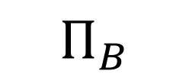
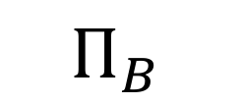
“Pushing down” projection
Lecture 17 > Section 1 > Plan Optimization
R(A,B)
S(B,C)
R(A,B)
S(B,C)
Why might we prefer this plan?

Slide 15
Takeaways
Lecture 17 > Section 1 > Plan Optimization
This process is called logical optimization
Many equivalent plans used to search for “good plans”
Relational algebra is an important abstraction.

Slide 16
RA commutators
Lecture 17 > Section 1 > Plan Optimization
The basic commutators:
  Push projection through (1) selection, (2) join
  Push selection through (3) selection, (4) projection, (5) join
  Also: Joins can be re-ordered!
Note that this is not an exhaustive set of operations
  This covers local re-writes; global re-writes possible but much harder
This simple set of tools allows us to greatly improve the execution time of queries by optimizing RA plans!

Slide 17
Optimizing the SFW RA Plan
Lecture 17 > Section 1 > Plan Optimization

Slide 18

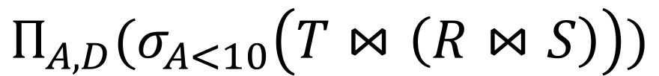
Translating to RA
Lecture 17 > Section 1 > Plan Optimization
R(A,B) S(B,C) T(C,D)
SELECT R.A,S.D
FROM R,S,T
WHERE R.B = S.B
AND S.C = T.C
AND R.A < 10;
σ_{Α<10}
T(C,D)
R(A,B)
S(B,C)

Slide 19
Logical Optimization
Lecture 17 > Section 1 > Plan Optimization
Heuristically, we want selections and projections to occur as early as possible in the plan
  Terminology: “push down selections” and “pushing down projections.”
Intuition: We will have fewer tuples in a plan.
  Could fail if the selection condition is very expensive (say runs some image processing algorithm).
  Projection could be a waste of effort, but more rarely.

Slide 20
Optimizing RA Plan
Lecture 17 > Section 1 > Plan Optimization
Push down selection on A so it occurs earlier
R(A,B) S(B,C) T(C,D)
SELECT R.A,S.D
FROM R,S,T
WHERE R.B = S.B
AND S.C = T.C
AND R.A < 10;
σ_{Α<10}
T(C,D)
R(A,B)
S(B,C)

Slide 21

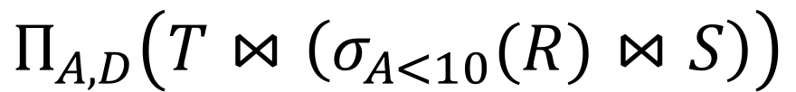
Optimizing RA Plan
Lecture 17 > Section 1 > Plan Optimization
Push down selection on A so it occurs earlier
R(A,B) S(B,C) T(C,D)
SELECT R.A,S.D
FROM R,S,T
WHERE R.B = S.B
AND S.C = T.C
AND R.A < 10;
T(C,D)
σ_{Α<10}
S(B,C)
R(A,B)

Slide 22
Optimizing RA Plan
Lecture 17 > Section 1 > Plan Optimization
Push down projection so it occurs earlier
R(A,B) S(B,C) T(C,D)
SELECT R.A,S.D
FROM R,S,T
WHERE R.B = S.B
AND S.C = T.C
AND R.A < 10;
T(C,D)
σ_{Α<10}
S(B,C)
R(A,B)

Slide 23


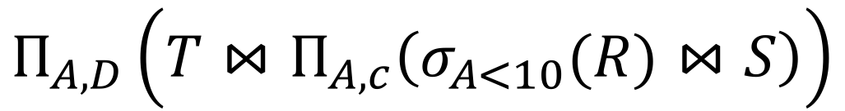
Optimizing RA Plan
Lecture 17 > Section 1 > Plan Optimization
We eliminate B earlier!
R(A,B) S(B,C) T(C,D)
SELECT R.A,S.D
FROM R,S,T
WHERE R.B = S.B
AND S.C = T.C
AND R.A < 10;
In general, when is an attribute not needed…?
T(C,D)
σ_{Α<10}
S(B,C)
R(A,B)

Slide 24
Activity-17-1.ipynb
Lecture 17 > Section 1 > ACTIVITY

Slide 25
2. Physical Optimization
Lecture 17 > Section 2

Slide 26
What you will learn about in this section
Lecture 17 > Section 2
Index Selection
Histograms
ACTIVITY

Slide 27
Index Selection
Lecture 17 > Section 2 > Index Selection
Input:
  Schema of the database
  Workload description: set of (query template, frequency) pairs
Goal: Select a set of indexes that minimize execution time of the workload.
  Cost / benefit balance: Each additional index may help with some queries, but requires updating
This is an optimization problem!

Slide 28
Example
Lecture 17 > Section 2 > Index Selection
Workload description:
SELECT pname
FROM Product
WHERE year = ? AND category = ?
Frequency10,000,000
SELECT pname,
FROM Product
WHERE year = ? AND Category = ?
AND manufacturer = ?
Frequency10,000,000
Which indexes might we choose?

Slide 29
Example
Lecture 17 > Section 2 > Index Selection
Workload description:
SELECT pname
FROM Product
WHERE year = ? AND category =?
Frequency10,000,000
SELECT pname
FROM Product
WHERE year = ? AND Category =?
AND manufacturer = ?
Frequency100
Now which indexes might we choose? Worth keeping an index with manufacturer in its search key around?

Slide 30
Simple Heuristic
Lecture 17 > Section 2 > Index Selection
Can be framed as standard optimization problem: Estimate how cost changes when we add index.
    We can ask the optimizer!
Search over all possible space is too expensive, optimization surface is really nasty.
  Real DBs may have 1000s of tables!
Techniques to exploit structure of the space.
  In SQLServer Autoadmin.
NP-hard problem, but can be solved!

Slide 31
Estimating index cost?
Lecture 17 > Section 2 > Index Selection
Note that to frame as optimization problem, we first need an estimate of the cost of an index lookup
Need to be able to estimate the costs of different indexes / index types…
We will see this mainly depends on getting estimates of result set size!

Slide 32
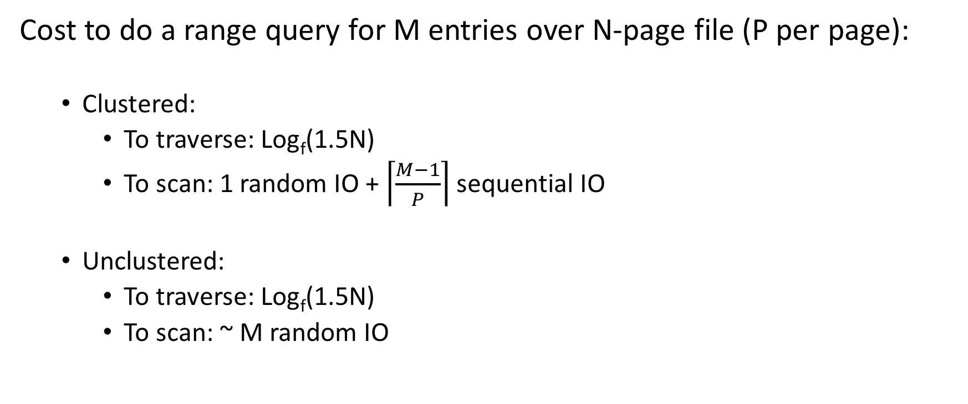
Ex: Clustered vs. Unclustered
Lecture 17 > Section 2 > Index Selection
Suppose we are using a B+ Tree index with:
Fanout f
Fill factor 2/3

Slide 33
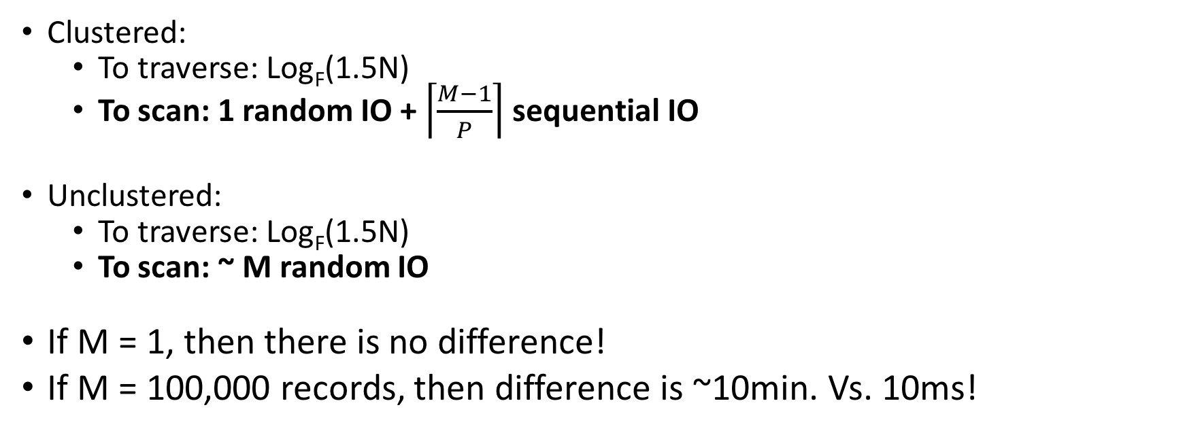
Plugging in some numbers
Lecture 17 > Section 2 > Index Selection
To simplify:
Random IO = ~10ms
Sequential IO = free
~ 1 random IO = 10ms
~ M random IO = M*10ms
If only we had good estimates of M…

Slide 34
Histograms & IO Cost Estimation
Lecture 17 > Section 2 > Histograms

Slide 35
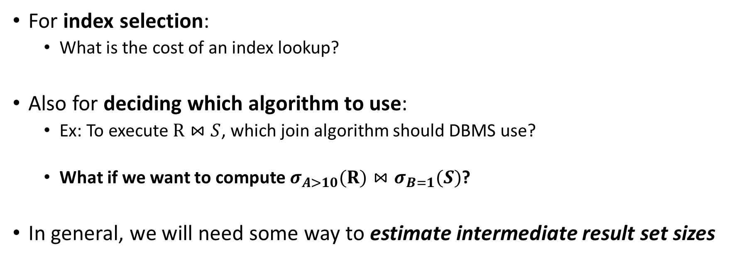
IO Cost Estimation via Histograms
Lecture 17 > Section 2 > Histograms
Histograms provide a way to efficiently store estimates of these quantities

Slide 36
Histograms
Lecture 17 > Section 2 > Histograms
A histogram is a set of value ranges (“buckets”) and the frequencies of values in those buckets occurring
How to choose the buckets?
  Equiwidth & Equidepth
Turns out high-frequency values are very important

Slide 37
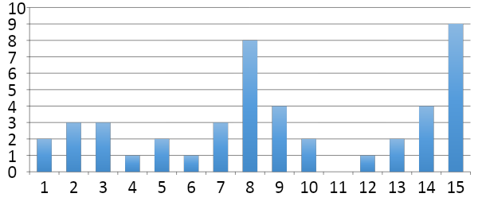
Example
Lecture 17 > Section 2 > Histograms
Frequency
How do we compute how many values between 8 and 10?
(Yes, it’s obvious)
Values
Problem: counts take up too much space!

Slide 38
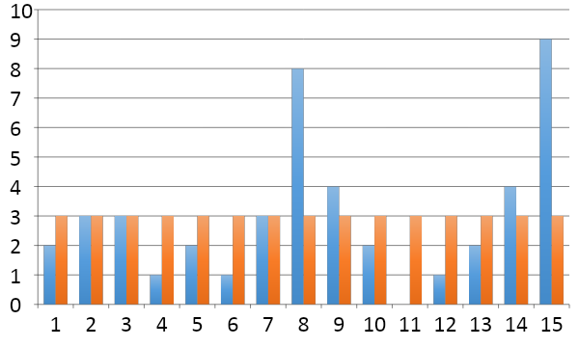
Full vs. Uniform Counts
Lecture 17 > Section 2 > Histograms
How much space do the full counts (bucket_size=1) take?
How much space do the uniform counts (bucket_size=ALL) take?

Slide 39
Fundamental Tradeoffs
Lecture 17 > Section 2 > Histograms
Want high resolution (like the full counts)
Want low space (like uniform)
Histograms are a compromise!
So how do we compute the “bucket” sizes?

Slide 40
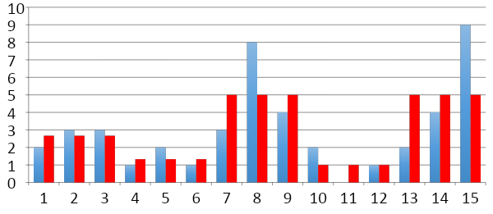
Equi-width
Lecture 17 > Section 2 > Histograms
All buckets roughly the same width

Slide 41
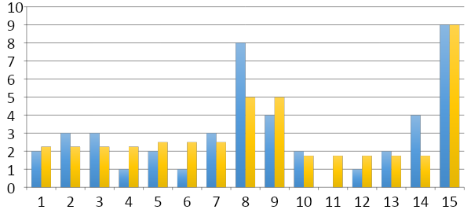
Equidepth
Lecture 17 > Section 2 > Histograms
All buckets contain roughly the same number of items (total frequency)

Slide 42
Histograms
Lecture 17 > Section 2 > Histograms
Simple, intuitive and popular
Parameters: # of buckets and type
Can extend to many attributes (multidimensional)

Slide 43
Maintaining Histograms
Lecture 17 > Section 2 > Histograms
Histograms require that we update them!
  Typically, you must run/schedule a command to update statistics on the database
  Out of date histograms can be terrible!
There is research work on self-tuning histograms and the use of query feedback
  Oracle 11g

Slide 44
Nasty example
Lecture 17 > Section 2 > Histograms
1. we insert many tuples with value > 16
2. we do not update the histogram
3. we ask for values > 20?

Slide 45
Compressed Histograms
Lecture 17 > Section 2 > Histograms
One popular approach:
  Store the most frequent values and their counts explicitly
  Keep an equiwidth or equidepth one for the rest of the values
  People continue to try all manner of fanciness here wavelets, graphical models, entropy models,…

Slide 46
Activity-17-2.ipynb
Lecture 17 > Section 2 > ACTIVITY

Slide 47
3. Course Summary
Lecture 17 > Section 3

Slide 48
Course Summary
Lecture 17 > Section 3
1. Intro
2-3. SQL
4. ER Diagrams
5-6. DB Design
7-8. TXNs
11-12. IO Cost
14-15. Joins
16. Rel. Algebra
We learned…
  How to design a database
  How to query a database, even with concurrent users and crashes / aborts
  How to optimize the performance of a database
We got a sense (as the old joke goes) of the three most important topics in DB research:
  Performance, performance, and performance

Slide 49
Course Summary
Lecture 17 > Section 3
1. Intro
2-3. SQL
4. ER Diagrams
5-6. DB Design
7-8. TXNs
11-12. IO Cost
14-15. Joins
16. Rel. Algebra
We learned…
  How to design a database
  How to query a database, even with concurrent users and crashes / aborts
  How to optimize the performance of a database
We got a sense (as the old joke goes) of the three most important topics in DB research:
  Performance, performance, and performance

Slide 50
Course Summary
Lecture 17 > Section 3
1. Intro
2-3. SQL
4. ER Diagrams
5-6. DB Design
7-8. TXNs
11-12. IO Cost
14-15. Joins
16. Rel. Algebra
We learned…
  How to design a database
  How to query a database, even with concurrent users and crashes / aborts
  How to optimize the performance of a database
We got a sense (as the old joke goes) of the three most important topics in DB research:
  Performance, performance, and performance

Slide 51
Course Summary
Lecture 17 > Section 3
1. Intro
2-3. SQL
4. ER Diagrams
5-6. DB Design
7-8. TXNs
11-12. IO Cost
14-15. Joins
16. Rel. Algebra
We learned…
  How to design a database
  How to query a database, even with concurrent users and crashes / aborts
  How to optimize the performance of a database
We got a sense (as the old joke goes) of the three most important topics in DB research:
  Performance, performance, and performance

